Slide 1
REQUIREMENT GATHERING REPORT
Adaptive E-Learning Platform Based on Quality of Experience (QoE) UNIVERSITY OF BUEA | FACULTY OF ENGINEERING AND TECHNOLOGY DEPARTMENT OF COMPUTER ENGINEERING | GROUP 9

Slide 2
GROUP 9 MEMBERS
NAME | MATRICULE
FONTEBO TCHICKNWIGHE ACHAH | FE23A062
ANU ROLENCE AKEM | FE23A013
NEIL AMBAYI MPOCHE | FE23A105
OTANG JANICE OTANG | FE23A134
ASHU ALBERIC BESSONG | FE23A015

Slide 3
1. INTRODUCTION
• The rapid advancement of digital technologies has significantly transformed the education sector.
• E-learning platforms are essential tools for teaching and learning, enabling access to resources regardless of geographical location.
• However, effectiveness depends on stable internet connectivity, adequate bandwidth, and appropriate digital devices.
• In low-resource environments such as Cameroon and Sub-Saharan Africa, users face challenges including unstable network connectivity, high data costs, limited bandwidth, and low-end devices.
• These constraints result in degraded learning experiences: video buffering, audio latency, session interruptions, and limited content access.
• This project focuses on the design of an adaptive e-learning platform based on Quality of Experience (QoE).
• The system dynamically adjusts content delivery modes (video, audio, text) based on real-time network conditions.
• The requirement gathering phase is critical for identifying user needs, system expectations, and contextual challenges.

Slide 4
2. STAKEHOLDER IDENTIFICATION
• Stakeholders are individuals, groups, or organizations directly involved in, affected by, or interested in the development and use of the system.
^{Primary Stakeholders:}
^{Students}
^{Lecturers}
^{Secondary Stakeholders:}
^{University Administration}
^{IT Support Staff}
^{External Stakeholders}
^{Parents / Guardians}
^{Internet Service Providers}

Slide 5
3. REQUIREMENT GATHERING TECHNIQUES
Requirement gathering techniques are structured methods used to collect relevant information from stakeholders to define system requirements accurately.
• ONLINE SURVEY (Google Forms)
• OBSERVATION
• BRAINSTORMING
Notes:
ONLINE SURVEY (Google Forms): A structured questionnaire distributed to students and lecturers to collect quantitative and qualitative data on user experiences, preferences, and challenges.
• OBSERVATION: Existing platforms like Zoom and Moodle were observed to identify limitations in low-bandwidth environments.
• BRAINSTORMING: Group discussions held to define adaptive system features such as video quality switching and audio fallback mode.

Slide 6
4. DATA GATHERING
• Data gathering is the systematic process of collecting raw information from stakeholders to understand existing problems and support system design decisions.
• Data was primarily collected through a Google Forms survey distributed to students and lecturers.
• COLLECTED DATA CATEGORIES: User role classification, Internet reliability during learning sessions, Preferred content format under poor connectivity, Features expected to improve learning experience, Satisfaction with existing platforms, Perception of challenges in low-resource environments, Device types used, Learning preferences and behavioral patterns, Open-ended suggestions for improvement.

Slide 7
4.2 DATA OVERVIEW — SURVEY QUESTIONS
• Which best describes you?
• How reliable is your internet connection during online learning sessions?
• During poor connectivity, what content format do you prefer?
• Which feature would improve your learning experience the most?
• What additional suggestions would improve online learning in low-resource environments?
• How satisfied are you with existing e-learning platforms?
• Do you think students in low-resource environments struggle with existing e-learning platforms?
• Internet quality of users, Device types, Learning preferences, Challenges faced in online learning.

Slide 8
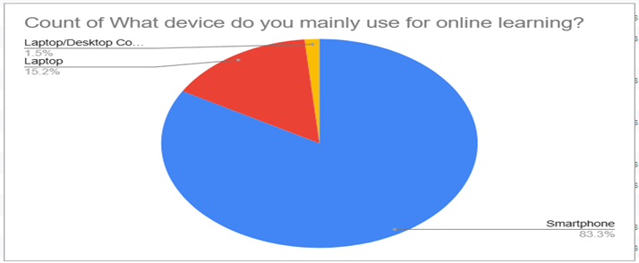
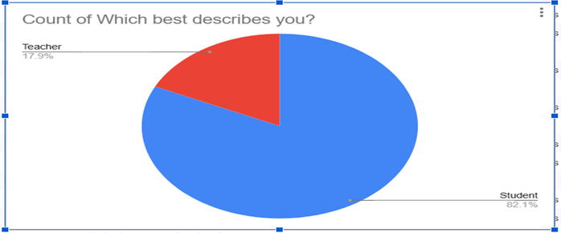
Data collected from survey

Slide 9
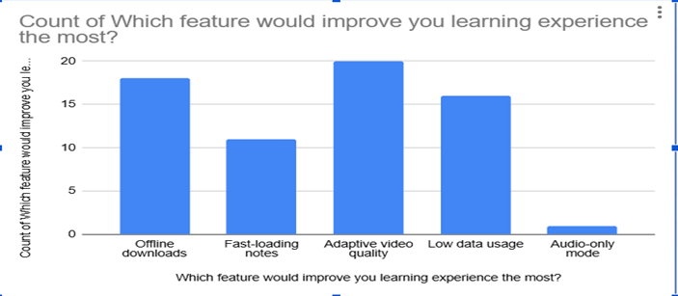
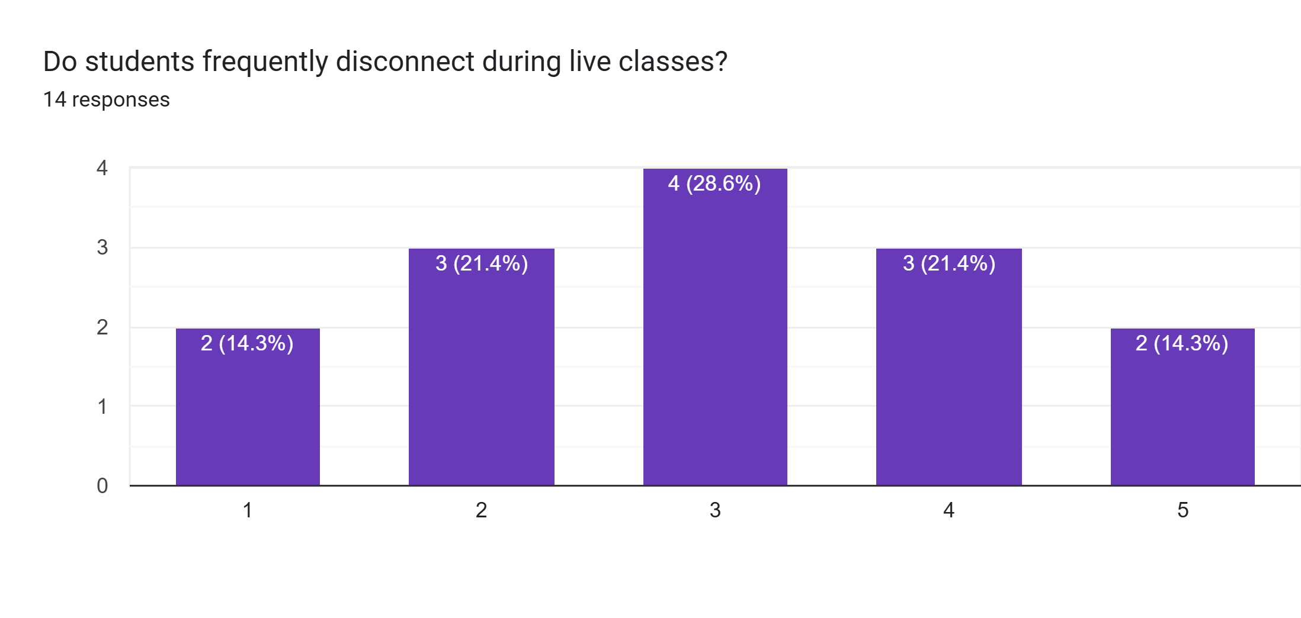
Data collected from survey

Slide 10
5. DATA CLEANING
• Data cleaning is the process of identifying and correcting inaccuracies, inconsistencies, and incomplete entries to ensure reliability for analysis.
• REMOVAL of incomplete or partially filled responses to ensure data integrity.
• TRIMMING of leading and trailing whitespace characters to standardize text entries.
• IDENTIFICATION AND ELIMINATION of duplicate records to avoid redundancy.
• DETECTION of missing values and replacement with standardized null indicators (NA) where appropriate.
• ADJUSTMENT of dataset structure for improved readability and analysis efficiency.
• OUTCOME: The cleaning process resulted in a refined dataset with improved consistency and reduced noise, enhancing reliability of subsequent analysis.

Slide 11
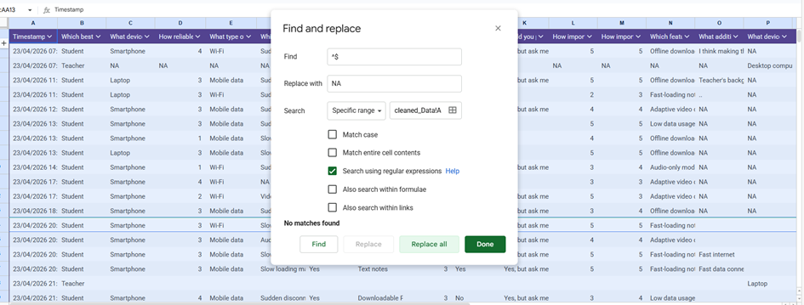
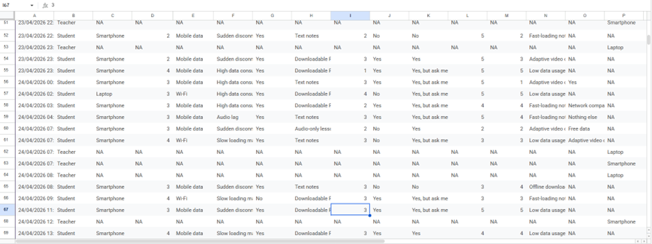
Data cleaning process
Finding empty spaces to replace them with NA
Output after replacing empty spaces with NA

Slide 12
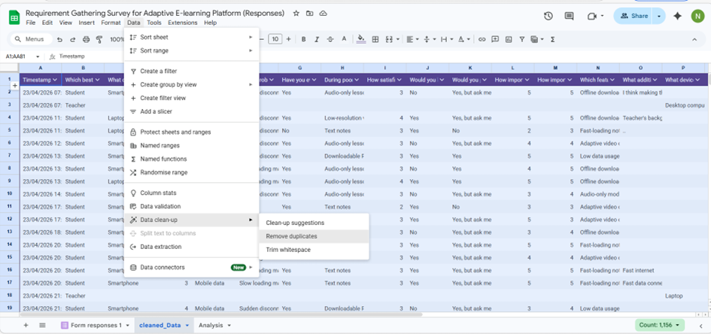
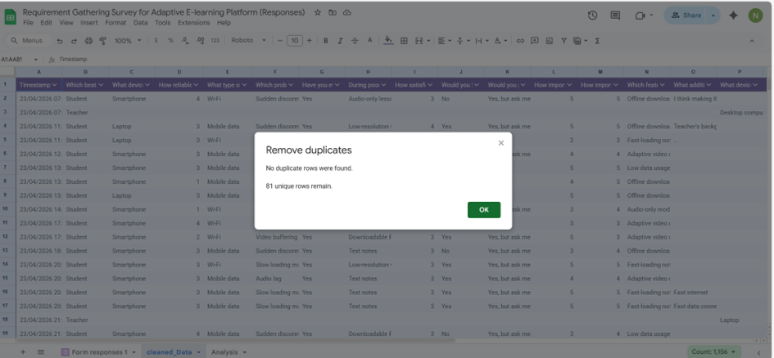
Data cleaning process: Eliminating duplicates

Slide 13
6. USER RELUCTANCE ASSESSMENT
• User reluctance refers to behavioral and contextual factors that hinder adoption and consistent use of a system.
• KEY BARRIERS IDENTIFIED:
• HIGH DATA COSTS significantly limit continuous access to e-learning platforms.
• POOR AND UNSTABLE NETWORK CONNECTIVITY discourages active participation in online learning activities.
• A SEGMENT OF USERS exhibits a preference for traditional classroom-based learning methods.
• LIMITATIONS IN DEVICE CAPABILITIES restrict access to multimedia-rich content.
• These findings indicate that both infrastructural and behavioral factors influence e-learning adoption in low-resource environments.

Slide 14
7. SUMMARY OF FINDINGS
• The requirement gathering process revealed several critical insights relevant to system design:
• NETWORK INSTABILITY is the most significant barrier affecting e-learning effectiveness.
• Users demonstrate a strong preference for LOW-DATA and LIGHTWEIGHT learning solutions.
• There is a clear need for ADAPTIVE CONTENT DELIVERY MECHANISMS capable of adjusting to network conditions.
• OFFLINE ACCESSIBILITY features are highly demanded by a significant proportion of users.
• These findings provide a foundational basis for the design of an adaptive e-learning system tailored to low-resource environments.

Slide 15
THANK YOU
Adaptive E-Learning Platform Based on QoE
GROUP 9 | UNIVERSITY OF BUEA

